Slide 1


Control statement and Classes
Fundamental Computer Programming C++
C1002-D
Dr. Ihsan Ullah
ihsan@saturn.yzu.edu.tw
Office: 60913

Slide 2
Introduction to Control Statements
In C++ programming language, all statements are executed sequentially from the top to the bottom. However, you can change the order (flow) of statements.
Control statements are fundamental components of programming languages like C++.
They enable you to control the flow of execution in your program.
Essential for decision-making and looping constructs.

Slide 3
Control Statements
if-statement: Executes code based on a condition.
if-else statement: Executes different code based on a condition.
switch-statement: Executes code based on different values of an expression.
while loop: Repeats code while a condition is true.
do-while loop: Repeats code at least once and then continues while a condition is true.
for loop: Repeats code for a specific number of iterations.

Slide 4
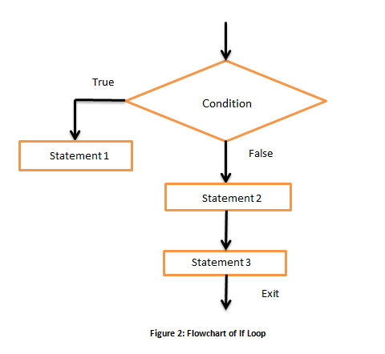
The if statement

Slide 5
The if statement
if statement.
condition returns a bool value.
{ } may be dropped if there is only one statement.
if (condition)
{
statements
}
In many cases, we hope that conditional on whether the condition is true or false, we do different sets of statements.
This is done with the if-else statement.
Do statements 1 if condition returns true.
Do statements 2 if condition returns false.
An else must have an associated if!
if(condition)
{
statements 1
}
else
{
statements 2
}

Slide 6
Example of the if-else statement
The income tax rate often varies according to the level of income.
E.g., 2% for income below $10000 but 8% for the part above $10000.
How to write a program to calculate the amount of income tax based on an input amount of income?
Which of the following two programs is correct (or better)?
double income = 0, tax = 0; double income = 0, tax = 0;
cout << "Please enter your income: "; cin >> income;
cout << "Please enter your income: "; cin >> income;
if (income <= 10000) tax = 0.02 * income;
if (income > 10000)
tax = 0.08 * (income - 10000) + 200;
if (income <= 10000) tax = 0.02 * income;
else
tax = 0.08 * (income - 10000) + 200;
cout << "Tax amount: $" << tax << "\n";
cout << "Tax amount: $" << tax << "\n";

Slide 7
Nested if-else statement
An if or an if-else statement can be nested in an if block.
In this example, if both conditions are true, statements A will be executed.
If condition 1 is true but condition 2 is false, statements B will be executed.
If condition 1 is false, statements C will be executed.
An if or an if-else statement can be nested in an
else block.
We may do this for any level of if or if-else.
if(condition 1)
{
if(condition 2)
{
statements A
}
else
{
statements B
}
}
else
{
statements C
}

Slide 8
The else-if statement
An if-else statement allows us to respond to a binary condition.
When we want to respond to a ternary condition, we may put an if-else statement in an else block:
if (a < 10)
cout << "a < 10."; else
{
if (a > 10)
cout << "a > 10."; else
cout << "a == 10.";
}
For this situation, people typically drop { } and put the second if behind else to create an else-if statement:
if (a < 10)
cout << "a < 10."; else if (a > 10)
cout << "a > 10."; else
cout << "a == 10.";

Slide 9
The else-if statement
An else-if statement is generated by using two nested if-else statements.
It is logically fine if we do not use else-if.
However, if we want to respond to more than three conditions, using else-if greatly enhances the readability of our program.
Another selection statement, switch-case, is (sometimes) more appropriate for a condition that has many realizations and will be introduced later.
if (month == 1) cout << "31";
else if(month == 2) cout << "28";
else if(month == 3) cout << "31";
else if(month == 4) cout << "30";
else if(month == 5) cout << "31";
// ...
else if(month == 11) cout << "30";
else
cout << "31";

Slide 10
Logic operators
In some cases, the condition for an if statement is complicated.
Logic operators are used to combine multiple conditions into one condition.
We have three logic operators:

Slide 11
Logic operators
Logical AND (&&):
Represents the logical AND operation.
Returns true if both condition1 and condition2 are true.
Logical OR (||):
Represents the logical OR operation.
Returns true if either condition1 or condition2 is true, or if both are true.
Logical NOT (!):
Represents the logical NOT operation.
Returns true if the condition is false, and false if the condition is true.

Slide 12
Logic operators: and
The “and” operator operates on two conditions.
– Each condition is an operand.
It returns true if both conditions are true. Otherwise, it returns false.
– (3 > 2) && (2 > 3) returns false.
– (3 > 2) && (2 > 1) returns true.
When we use it in an if statement, the grammar is:
if(condition 1 && condition 2)
{
statements
}

Slide 13
Logic operators: and
An “and” operation can replace a nested if statement.
– The nested if statement
if (a > 10)
{
if (b > 10)
cout << "a is between 10 and 20;";
}
is equivalent to
if (a > 10 && b > 10)
cout << "a is between 10 and 20;";

Slide 14
Preparations
Selection
Repetition
Logic operators: or
The “or” operator returns true if at least one of the two conditions is true. Otherwise it returns false.
– (3 > 2) || (2 > 3) returns true.
– (3 < 2) || (2 < 1) returns false.
When the or operator is used in an if statement, the grammar is
If(condition 1 || condition 2)
{
statements
}

Slide 15
Logic operator: not
The “not” operator returns the opposite of the condition.
!(2 > 3) returns true.
!(2 > 1) returns false.
It is used when we have statements only in the else block:
The following two programs are equivalent:
if(condition)
;
else
{
statements
}
if(!condition)
{
statements;
}

Slide 16
The switch-case statement
switch (operation)
The second way of implementing a selection is to use a switch-case statement.
It is particularly useful for responding to
multiple values of a single operation.
For the operation:
It can contain only a single operand.
It must return an integer (int, bool, char, etc.).
{
case value 1: statements break;
case value 2: statements break;
. .
default: statements break;
}

Slide 17
The switch-case statement
After each case, there is a value.
If the returned value of the operation equals that value, those statements in the case block will be executed.
No curly brackets are needed for blocks.
A colon is needed after the value.
A break marks the end of a block.
The break of the last section is optional.
Restrictions on those values:
Cannot be (non-constant) variables.
Must be different integers.
The default block will be executed if no case value matches
switch (operation)
{
case value 1: statements break;
case value 2: statements break;
. .
default: statements break;
}

Slide 18
The default block
The default block will be executed if no case value matches the operation’s return value.
You may add a break at the end of
default or not. It does not matter.
int a; cin >> a;
switch(a)
{
case 10:
cout << "a is ten."; break;
case 20:
cout << "a is twenty."; break;
default:
cout << a << "\n";
}

Slide 19
The do-while statement
Recall that we validated a user input with a
while statement:
One drawback of this program is that a set of same codes must be written twice.
– Inconsistency may then arise.
To avoid such a situation, we may use a do- while statement.
char a = 0;
// do something cout << "Exit? "; cin >> a;
while (a != 'y' && a != 'Y')
{
// do something cout << "Exit? "; cin >> a;
}

Slide 20
The do-while statement
The grammar:
do
{
statements
} while (operation);
The revision of the previous program:
char a = 0;
do
{
// do something cout << "Exit? "; cin >> a;
} while (a != 'y' && a != 'Y');
In any case, statements in a do-while
loop must be executed at least once.
The semicolon is needed.
– Why?

Slide 21
The for statement
for (init; cond; some)
{
statements
}
You need those two “;” in the ( ).
The typical way of using a for statement is:
init: Initialize a counter variable here.
cond: Set up the condition on the counter variable for the loop to continue.
some: Modify (mostly increment or decrement) the counter variable.
statements: The things that we really want to do.

Slide 22
for vs. while
Let’s calculate the sum of 1 + 2 + … + 100:
We used while. How about for?
To use for:
We declare and initialize the counter variable i: int i = 1.
We check the loop condition: i <= 1000.
We run the statement: sum = sum + i;.
We then increment the counter: i++. i
becomes 2.
Then we go back to check the condition, and so on, and so on.
int sum = 0; int i = 1;
while (i <= 100)
{
sum = sum + i; i = i + 1;
}
cout << sum << "\n";
int sum = 0;
for (int i = 1; i <= 100; i++) sum = sum + i;
cout << sum;

Slide 23
Multi-counter for loops
Inside one for statement:
You may initialize multiple counters at the same time.
You may also check multiple counters at the same time.
You may also modify multiple counters at the same time.
Use “,” to separate operations on multiple counters.
If any of the conditions is false, the loop will be terminated.
As an example:
for(int i = 0, j = 0; i < 10, j > -5; i++, j--) cout << i << " " << j << "\n";
Try to find alternatives before you use it.

Slide 24
Nested loops
Like the selection process, loops can also be nested.
Outer loop, inner loop, most inner loop, etc.
Nested loops are not always necessary, but they can be helpful.
Particularly when we need to handle a multi-dimensional case.
E.g., write a program to output some integer points on an (x, y)-plane like this:
(1, 1) (1, 2) (1, 3)
(2, 1) (2, 2) (2, 3)
(3, 1) (3, 2) (3, 3)
This can still be done with only one level of loop. but using a nested loop is much easier.
for (int x = 1; x <= 3; x++)
{
for (int y = 1; y <= 3; y++)
cout << "(" << x << ", " << y << ") ";
cout << " ";
}
// where to output a new line character?

Slide 25
Infinite loops
An infinite loop is a loop that does not terminate.
int a = 0; while(a >= 0)
a++;
while(true) cout << 1;
for(; ; ) cout << 1;
Usually, an infinite loop is a logical error made by the programmer.
– When it happens, check your program.
When your program does not stop, press <Ctrl + C>.

Slide 26
Jump statements
Break and continue
When we implement a repetition process, sometimes we need to further change the flow of execution of the loop.
A break statement brings us to exit the loop immediately.
When continue is executed, statements after it in the loop are skipped.
The looping condition will be checked immediately.
If it is satisfied, the loop starts from the beginning again.
How to write a program to print out all integers from 1 to 100 except multiples of 10?
for (int a = 1; a <= 100; a++)
{
if(a % 10 != 0)
cout << a << " ";
}
for (int a = 1; a <= 100; a++)
{
if (a % 10 == 0)
continue;
cout << a << " ";
}

Slide 27
break and continue
The effect of break and continue is just on the current level.
If a break is used in an inner loop, the execution jumps to the outer loop.
If a continue is used in an inner loop, the execution jumps to the condition check of the inner loop.
What will be printed out at the end of this program?
int a = 0, b = 0; while(a <= 10)
{
while(b <= 10)
{
if(b == 5) break;
cout << a * b << "\n"; b++;
}
a++;
}
cout << a << "\n"; // ?

Slide 28
What is class
A blueprint for creating objects that defines their structure and behavior.
To encapsulate related data and functions into a single unit.
Example:
class Car {
public:
string brand;
string model;
int year;
};
Control Statements
28

Slide 29
Class Members:
Data members: Variables declared within the class to store data.
Member functions: Functions declared within the class to perform operations on the data.
Access specifiers:
Public: Accessible from outside the class.
Private: Accessible only within the class.
Protected: Accessible within the class and its subclasses.
Control Statements
29

Slide 30
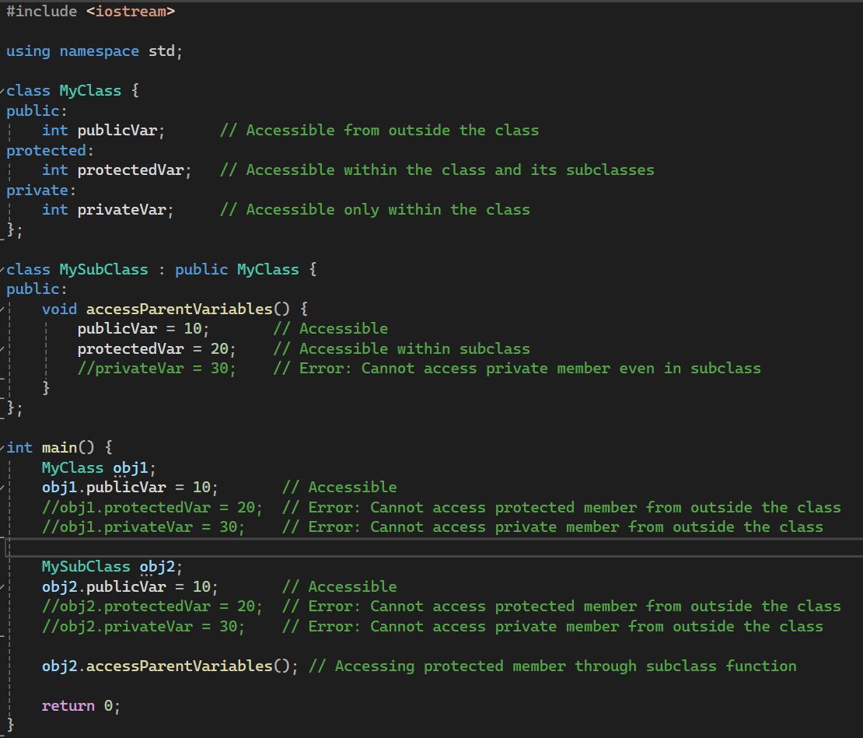
Class Members:
Control Statements
30

Slide 31
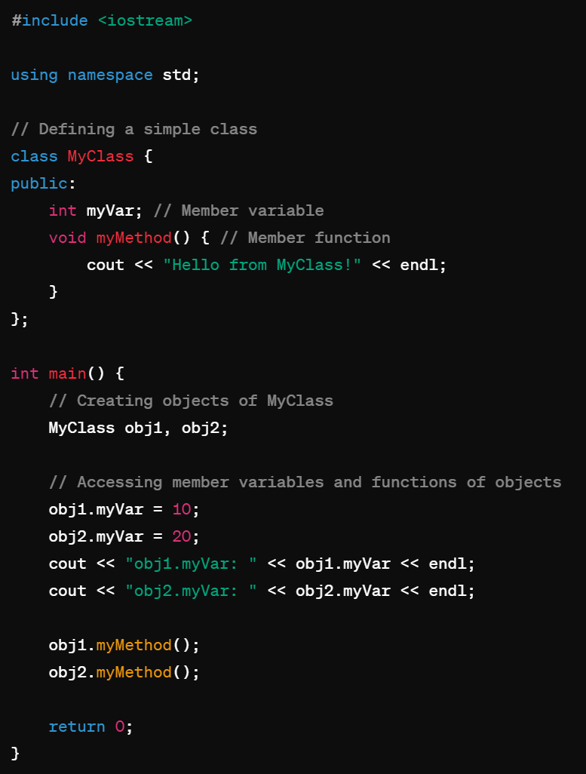
Creating Objects:
Instantiating objects from a class:
We define a class MyClass with a member variable myVar and a member function myMethod().
In main(), we create two objects obj1 and obj2 of type MyClass.
We access the member variable myVar and assign values to it for each object.
We call the member function myMethod() for each object.
Finally, we output the values of myVar for each object.
Control Statements
31

Slide 32
Instance vs. static variables
In a class, we can define variables and functions.
They are call member variables and member functions.
However, now there can be four types of class members:
Instance variables (default).
Static variables.
Instance functions (default).
Static functions.
Starting from now, when we say member variables (fields) and member functions, we are talking about instance ones.
Control Statements
32

Slide 33
Instance and static variables
Instance Variables:
Variables unique to each object, holding data specific to that instance.
Static Variables:
Variables shared among all objects of the class, containing data common to all instances.
Control Statements
33

Slide 34
Instance and static variables
Instance variables are unique to each object, while static variables are shared among all objects of a class.
b1.y = 30
b1.y =
30
b2.y = 40
b1.x = 10
b1.x =
10
b1.y = 30
b1.x = 20
b2.x =
20
30
40
b1.y =
b2.y = 40
Control Statements
34

Slide 35
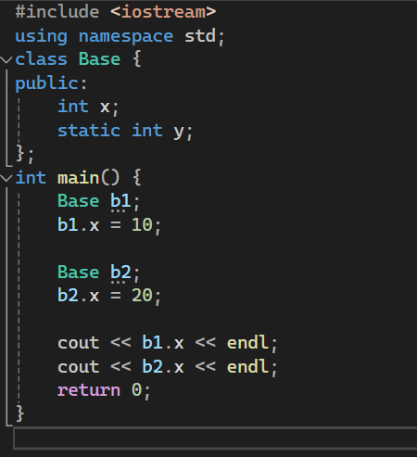
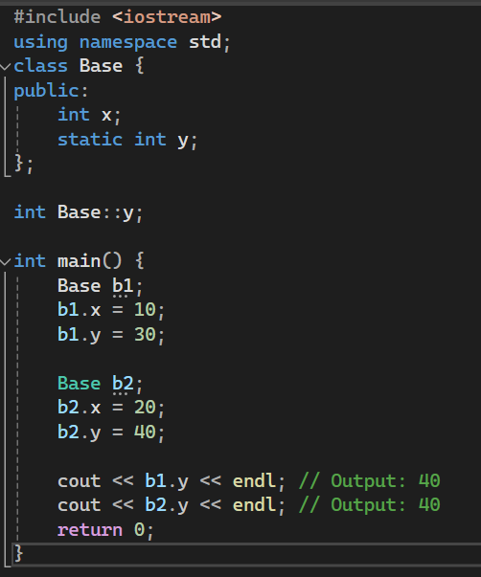
Instance and static variables
Output:
10
20
Output:
40
40
Control Statements
35

Slide 36
Visibility
We can/must set visibility of members in a class:
Public members can be accessed anywhere.
Private members can be accessed only in the class.
Protected members will be discussed later in this semester.
These three keywords are the visibility modifiers.
By default, all members’ visibility level is private.
Usually all instance variables are private.
Control Statements
36

Slide 37
Private instance functions
In an instance function, we can invoke an instance function.
Set an instance function private if it should be not accessed by others.
class MyVector {
private: int n; int* m; int max();
public:
void init(int dim); void print();
void printMax();
};
int MyVector::max() {
int max = m[0];
for(int i = 1; i < n; i++) { if(m[i] > max)
max = m[i];
}
return max;
}
void MyVector::printMax() {
cout << "Max: " << max() << "\n";
}
Control Statements
37

Slide 38
Constructors
A constructor is an instance function of a class.
However, it is very special.
A constructor will be invoked automatically when the object is created.
It must be invoked.
It cannot be invoked twice.
It cannot be invoked by the programmer manually.
Usually it is used to initialize the object.
Control Statements
38

Slide 39
Destructors
A destructor is invoked right before an object is destroyed.
– It must be public and have no parameter.
The compiler provides a default destructor that does nothing.
To define your own destructor, use ~:
Control Statements
39

Slide 40
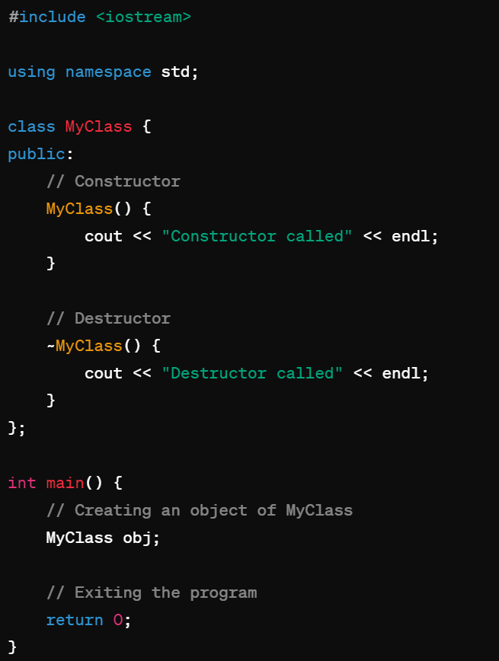
Constructors and Destructors
Special member functions automatically called when an object is created.
Used to initialize object's data members and set up its state.
Have the same name as the class.
Can be overloaded, allowing multiple constructors with different parameter lists.
Control Statements
40

Slide 41
Thanks
Any Question?

